Slide 1
Improving Diversity of the Local Supply Chain
Partners In Procurement Event
Sibusiso Tshabalala & Tutu Adebiyi – (Black South West Network)
Niotia Ferguson – Head of Procurement & Contract Management
(Bristol City Council)

Slide 2

City of Bristol – Diversity
African 3.8%
  BRISTOL it has a population of 465,900 and is the seventh largest English city outside London. It is a rapidly growing city, with a diverse population made up of: 72% white British and 18% Ethnic Minorities
  We believe it’s important that the suppliers who deliver services to Bristol support our equality and diversity aims and reflect our city.
The Council spends around £600 million a year buying a diverse range of works, goods and services from thousands of suppliers to deliver works and services to residents, businesses and stakeholders across the city.
55.9% of our contractual spend is with micro, small and medium-sized suppliers.
Approximately 40% of our spend is with organisations based in BS1-16 postcodes.
Pakistani 1.9%
Other Black 0.6%
Gypsy/Irish Traveller 0.1%
Chinese 1.2%
Indian 1.8%
Arab 0.5%
Mixed Groups 4.5%
Caribbean 1.8%
Bangladeshi 0.6%
Other White 8.3%
Other Asian 1.2%
Roman 0.2%
Other 1.4%
Irish 0.9%
Notes:
Our pdfEquity and Inclusion Strategic Framework 2023 to 2027 (pdf, 1.78 MB) sets out how we will:
tackle equalities issues
aim to eliminate discrimination
create good relationships between communities in Bristol
ensure those from different backgrounds have similar life opportunities
The Council spends around £600 million a year buying a diverse range of works, goods and services from thousands of suppliers to support the delivery of works and services to residents, businesses and stakeholders.
55.9% of our contractual spend was with micro, small and medium-sized suppliers.
Approximately 40% of our spend is with organisations based in BS1-16 postcodes.

Slide 3

Covid19 - Impact on Adult Social Care (ASC)
In 2020 Covid19 had a worldwide detrimental impact on many sectors but in particular the Adult Social Care.
Bristol’s Voluntary Community Social Enterprise (VCSE) ASC providers, worked closely with the local authority and health institutions to create major caring networks
ASC required more flexibility to promptly meet the needs of;
older people,
disabled people,
extremely clinically vulnerable people,
racialised communities, and several more individuals who needed access to care whilst being in lockdown or isolating.
BCC commissioned Bristol South West Network to deliver the ‘Make It Work’ Programme
Notes:
Response to the highlighted need to diversify our supply chain to address Black and Minoritised communities and support the ASC need and detrimental impact of C19 on local community suppliers. How can Procurement and Tendering improve in this area.
Introduce Tutu & Sibs

Slide 4



Make it Work
Building Equity within the Adult Social Care Market in Bristol
Copyright © 2023 Black South West Network

Slide 5


MAKE IT WORK PROGRAMME KEY OBJECTIVES:
1) Improving the quality of services for Black and Minoritised communities
2) Increasing diversity and economic opportunities in the ASC market
3) Enhancing overall access to care via alternative financial models
Notes:
To provide Black and Minoritised providers with support they need to better position receive funding and commissioning.
Organisations to understand how to remove unnecessary or inappropriate process which currently limit the ability of Black and Asian organisations to succeed.

Slide 6

Learning

Slide 7
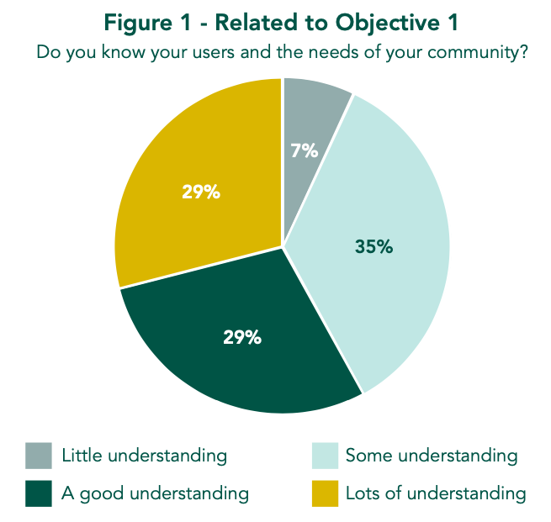
Barriers to Contracting: Systemic Disadvantage
Lack of Capacity
“I’ve spoken a lot about the skillset, the diversity, the local knowledge and local intelligence of those community organisations, the richness of the combined skills across the various organisations.
Without a shadow of doubt, coming from the space of knowing the actual citizens that the commissioners want to support, they all had that.”
Interview 1 – Programme Consultant 1
The framework is perceived as bureaucratic and time-consuming.
Lack of Information
The process is inequitable for smaller and/or newer organisations.
Poor Communication/Visibility
Expectations/questions are unclear, resulting in communication failures. Disconnection from the community.

Slide 8
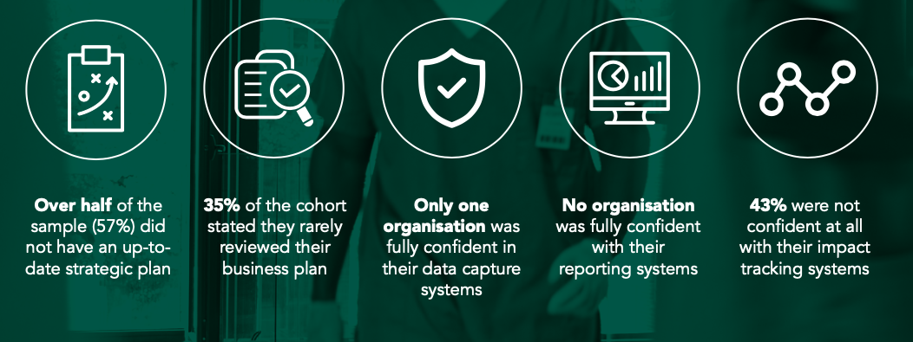
The State of the Sector Before the MiW Programme

Slide 9
The Types of Support Needed
Technical support for increasing contract-readiness within organisations, which often included support with registering on the Pro-Contract Council’s Tendering and Contracts System and with becoming CQC registered.
Financial guidance to increase sustainability via alternative routes, e.g., through enhancing understanding of ISFs, DPs and CIAs.
Business development support, which as previously mentioned included impact tracking, data capturing and reporting, but also risk assessment and risk management, budgeting and governance and accountability.
Building a relational approach to allow for better communication and understanding between the Bristol Black and Minoritised ASC providers and the commissioners and procurement officers at Bristol City Council.
Creating spaces and opportunities for peer learning and networking between the Black and Minoritised ASC providers sector to build on each other’s knowledge and skillsets, as much as on each other’s resilience and strengths.
Notes:
This would have responded in turn to various other challenges, such as the organisations’ need for equitable access to information on current commissioning opportunities and more accessible, active and responsive communication channels when requesting clarity on tendering processes.
This area became the central workstream during Phase 2 of MIW, where a consortium of 6 organisations was established.

Slide 10

Evaluation

Slide 11
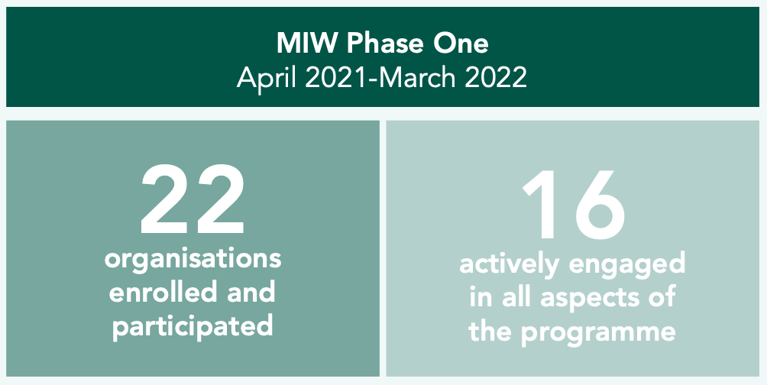

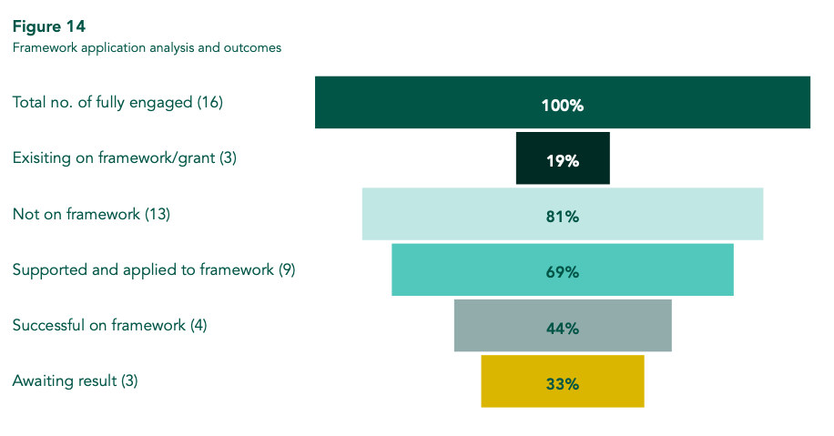
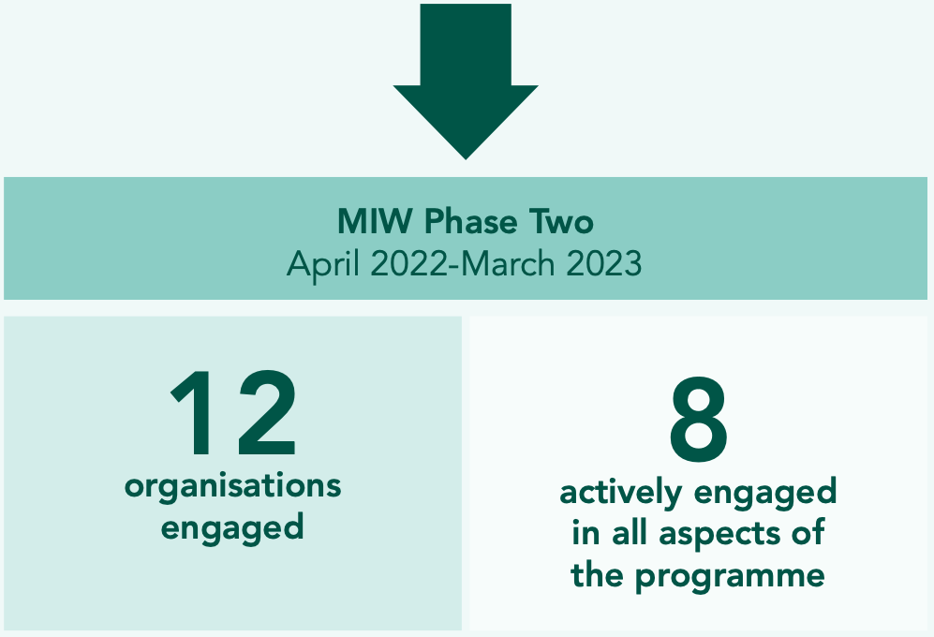
Overview of Phase One & Two

Slide 12
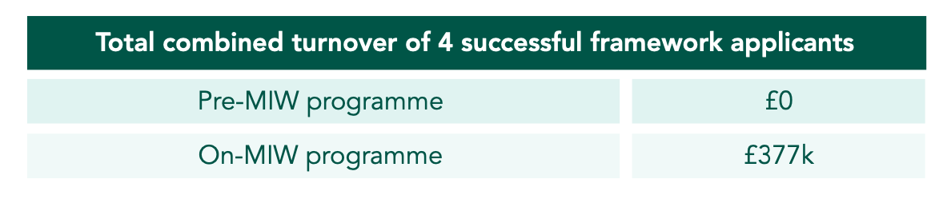
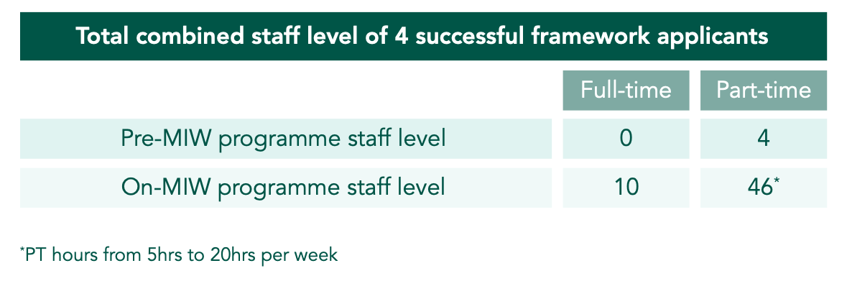
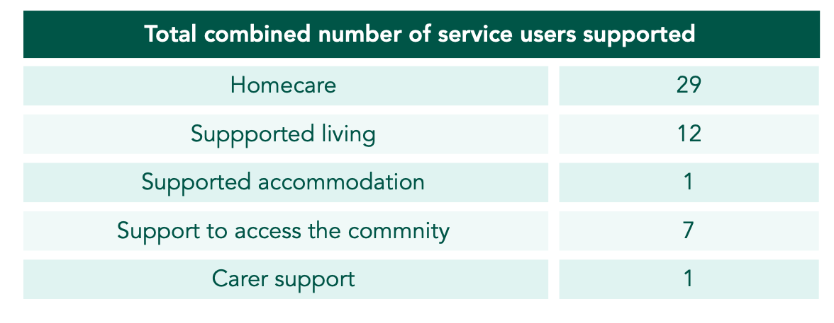
Economic Benefits of Providing Homecare & Community Support Services

Slide 13
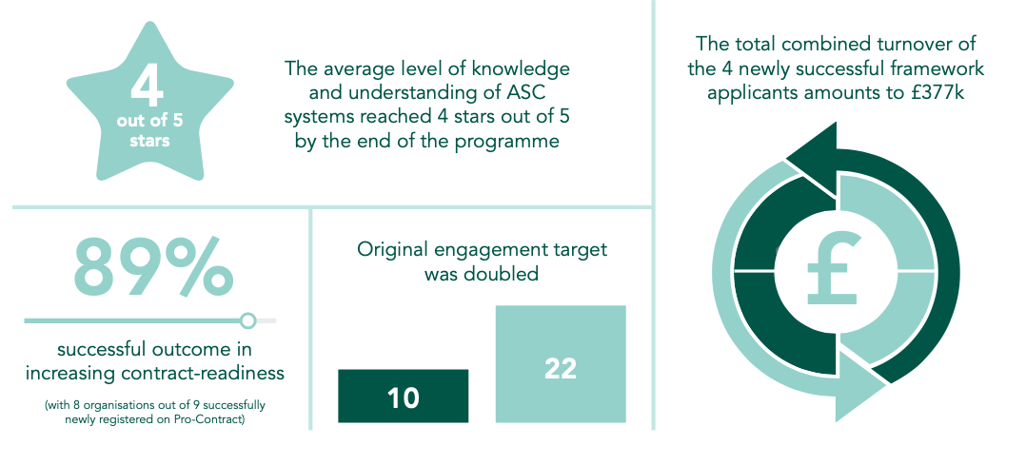
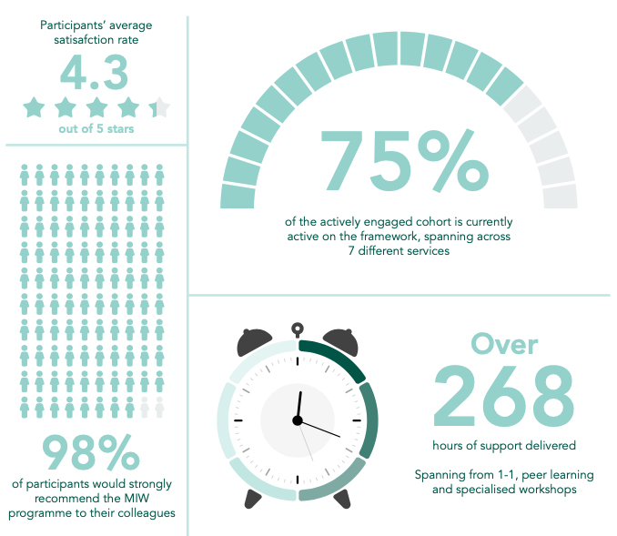
Impact Highlights

Slide 14
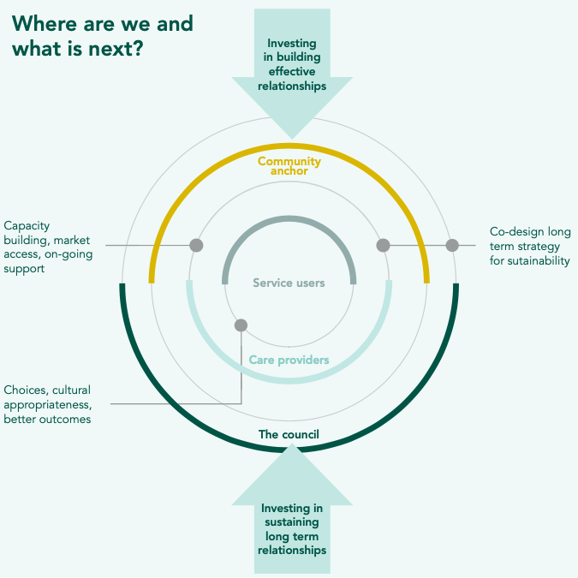
Where are we

Slide 15
Recommendations
1) Investing into capacity-build under-developed organisations to increase their access to the market and build their track-record.
2) Moving towards the co-production of type- based processes, e.g., there is opportunity for social capital organisations to act as Introductory Agencies and deliver services through micro-org and self-employed.
3) Moving away from transactional and traditional commissioning to a range of relational commissioning processes.
5) Post contracting (on-going and long- term) relationship and support to ensure service performance, greater outcomes, and sustainability.
6) Diversity in Buyers Supplier Forum or Strategy Development.
7) Representation in the procurement and contract Management Scrutiny Panel.

Slide 16
Quotes from Participants to the MiW Programme
“I think definitely the programme has opened up the lines of communication a lot better and not only the communication but the opportunities because speaking to commissioners, we are able to identify […] that there are more opportunities I didn’t even pick up on Pro- Contract before.”
“I would have given up without your support.”
“There was such a high level of data intelligence that I felt through this project. I was able to use it in order to devise or put together my bid that is in line with the standards or the costing for the tenders I was looking into. It has just really helped me so much.”

Slide 17
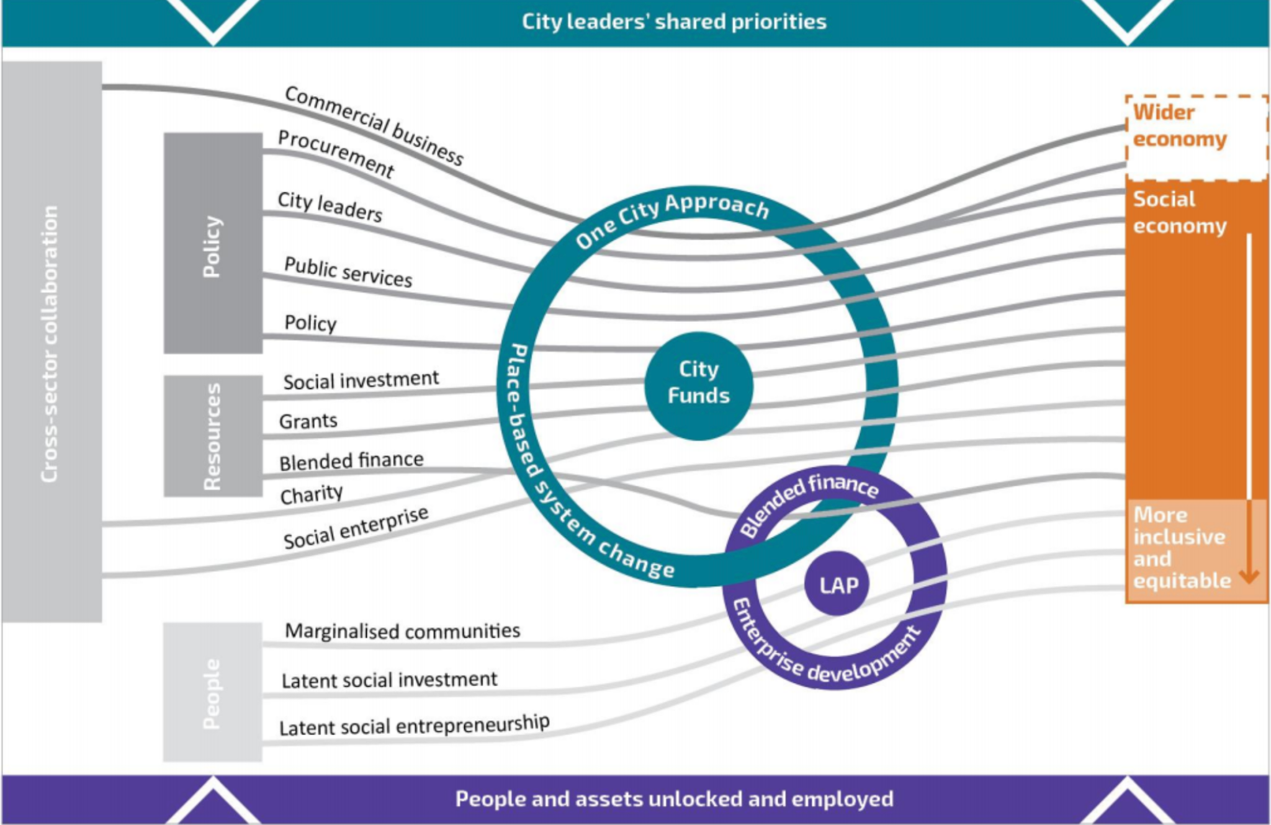
City Leaders shared priorities

Slide 18
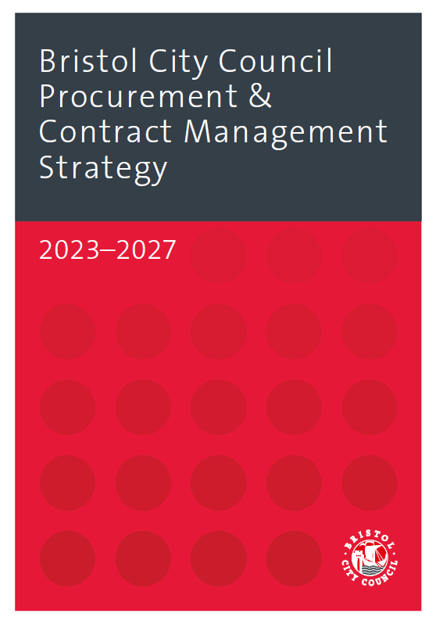
BCC Procurement & Contract Management Service
Aims:
Explore new equitable ways of commissioning with smaller providers specialised in caring for racially minoritised communities. Aligns to the BCCs Equity and Inclusion Strategic Framework 2023 to 2027
BEST VALUE
FAIR & COMPLIANT
LOCAL COMMUNITIES
HEALTHY & SUSTAINABLE
Notes:
This strategy detail our vision by applying four guiding principles to our procurement and contract management activity
The council’s Corporate Strategy sets out the council’s contribution to the city and is our main strategic document. It informs everything we do and sets out our main priorities for 2022 to 2027. The Corporate Strategy outlines a vision of driving an inclusive, sustainable and healthy city of hope and aspiration where everyone can share the city’s success. It also describes the activities the Council must do by law.
1.2. The council has responsibility for an incredibly diverse range of services – including everything from caring for the most vulnerable children in our city, through to building new transport infrastructure to keep our city moving. Everything we do relies in some way on the goods, services and works we buy. This means that procurement and contract management decisions have a direct impact on

Slide 19
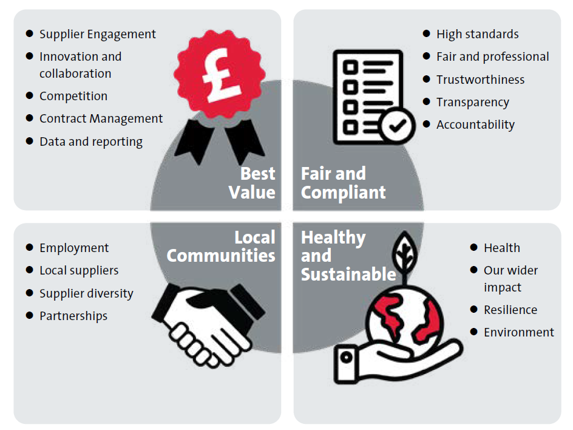
BCC Procurement & Contract Management Services
Contract Management Framework
Workshops
Modern Day Slavery
Ethical & Equitable
Black Pound
MSME’s Engagement Workshops
Social Value
Climate Emergency
Sustainability
Carbon Reporting

Slide 20
Tendering Tips for Suppliers
Get ready!
Review Commissioning Intentions
Policies, Accreditations etc
Register on e-Procurement Portals
Attend Market Engagement Days/workshops
Read online Corporate Aims
Bidding
Answer the question
Demonstrate how you meet the needs of the requirement
Use your Social Value submission/commitments to demonstrate what you can give back to local communities
Explore consortium bids
Ask clarification questions if you are unclear

Slide 21
Thank You For Listening

